Slide 1
Machine Learning in Cardiovascular-related Textual Data
By Kushagra Rastogi

Slide 2
Objectives
To discover the main topics in a document
To identify similar features between documents and predict features that are missing

Slide 3
Some Background
Medical clinical reports from PubMed
Length: 10 to 40 sentences
MESH-related terms

Slide 4
Sample Report
Patient was a 34-yr-old man … presented with complaints of fever and a chronic cough. He was a smoker … history of pulmonary tuberculosis … A computed tomographic (CT) scan revealed ... A thoracoscopic lung biopsy ... The microscopic examination revealed a typical LCH … and they formed small aggregations around the bronchioles ... proteins positive for S-100 protein, vimentin, CD68 and CD1a … Now, at five months after lobectomy, the patient is doing well …

Slide 5
Initial Approach
Clean data
Vectorize
Modelling
Performance metric
Tuning
TF-IDF
Cosine Similarity
Latent Semantic Analysis

Slide 6
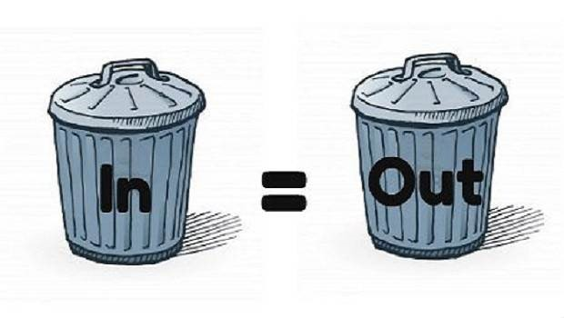
Unfortunately…
Credit: International Institute of Analytics

Slide 7
Refined Approach
MESH dictionary
Clean data
Vectorize
Topic Modelling
Evaluation
Bag-of-Words
Dominant Topic
Topic Distribution
PubMed MESH Browser
Latent Dirichlet Allocation

Slide 8
MESH Dictionary
~86,000 words
Patient
Disease
Blood
Dimethoxyphenylethylamine
Tumor
Hemipelvectomy
Lesion
Therapy
Year

Slide 9
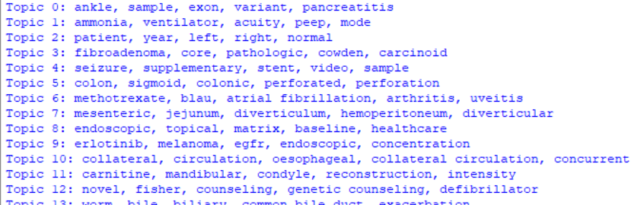
Topics

Slide 10
Dominant Topics (based on probability scores)
Least dominant
Most dominant

Slide 11
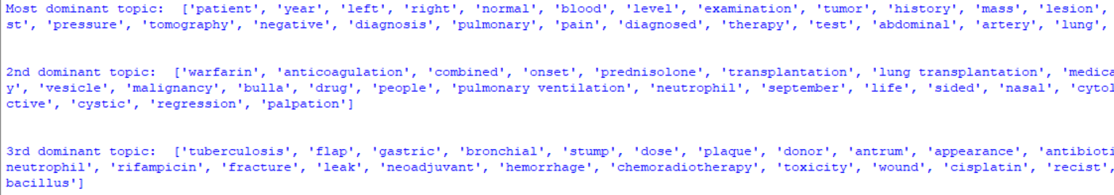
Informativeness

Slide 12

Conclusions
Dominance $≠$ Informativeness
Less dominant topics contain characteristic terms

Slide 13
Meta-topics
Ensemble
Topic 1
Topic 2
Topic 3
Topic 4

Slide 14
Next Steps
Topic distribution
Topic weights
Meta-topics
Predict
1.
Topics
Map to ICD10
Predict
2.

Slide 15
Thank You!

Slide 16
Bibliography
https://iianalytics.com/research/supply-chain-planning-is-garbage-in-garbage-out

